Slide 1
Expert Systems

Slide 2
What is an Expert System?
Experts are people who are very familiar with solving specific types of problems.
Expert System
Until now, no unified definition has been given.
Knowledge-based system
The fundamental function of the expert system depends upon its knowledge, therefore, the expert system is sometimes called knowledge-based system.

Slide 3
What is an Expert System(ES)?
Definition 1: ES can handle real-world complex problems which need an expert’s interpretation and solve problems by using a computer model of human expert reasoning to reach the same conclusions that the human expert would do if he or she faces with a comparable problem.
Definition 2: ES is an intelligent computer program that uses knowledge and inference procedures to solve problems that are difficult enough to require significant human expertise for their solutions.
Notes:
Here just are several kinds of definitions of Expert system.
(念PPT)

Slide 4
What is an Expert System?
In short, an ES is an intelligent computer program that can perform special and difficult task(s) in some field(s) at the level of human experts.

Slide 5
Characteristics of ES
Expert systems can be distinguished from conventional computer systems in that:
1. They simulate human reasoning about the problem domain, rather than simulating the domain itself.
2. They perform reasoning over representations of human knowledge, in addition to doing numerical calculations or data retrieval. They have corresponding distinct modules referred to as the inference engine and the knowledge base.

Slide 6
Conti..
3. Problems tend to be solved using heuristics (rules of thumb) or approximate methods or probabilistic methods which, unlike algorithmic solutions, are not guaranteed to result in a correct or optimal solution.
4. They usually have to provide explanations and justifications of their solutions or recommendations in order to convince the user that their reasoning is correct.
Note that the term Intelligent Knowledge Based System (IKBS) is sometimes used as a synonym for Expert System.

Slide 7
Basic components
ES has been structured in many ways.
The various ES architecture include different components
• Basic components:
1. User interface
2. Knowledge base
3. Inference engine

Slide 8
Continue…
1. User interface:
  A software that provides for the communication exchange between user and the system
  User: input facts, ask the system
  System: ask new facts, give answer or advice
2. Knowledge base:
  Contains expert-level knowledge on a particular subject Stored in a knowledge representational form
3. Inference engine:
  A software that performs the inference reasoning tasks
  It uses the knowledge in the knowledge base and
  information provided by the user to infer new knowledge

Slide 9
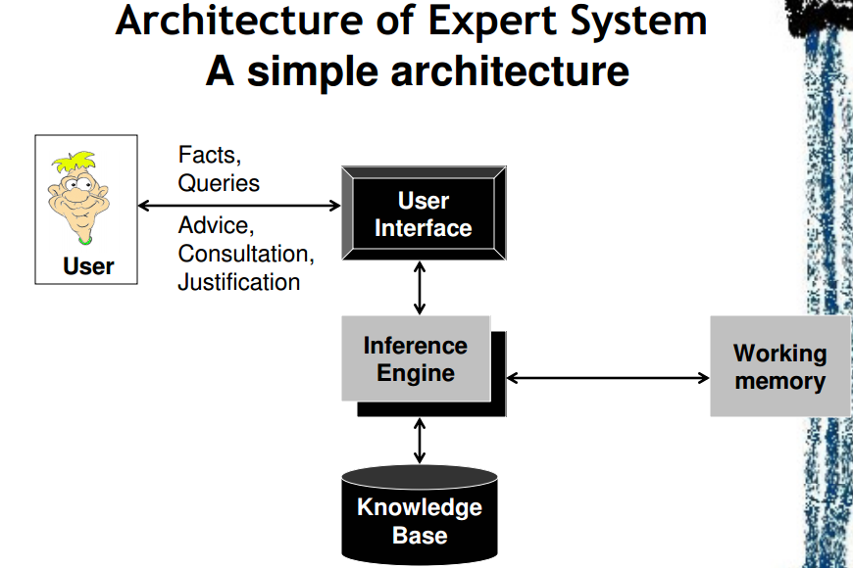
Basic architecture

Slide 10
Other components
Working memory:
A global database of facts used by the rules
2. Knowledge database:
Contains rules about the behavior of the elements of a particular subject
3. Domain database:
Contains facts about the ES’s subject

Slide 11
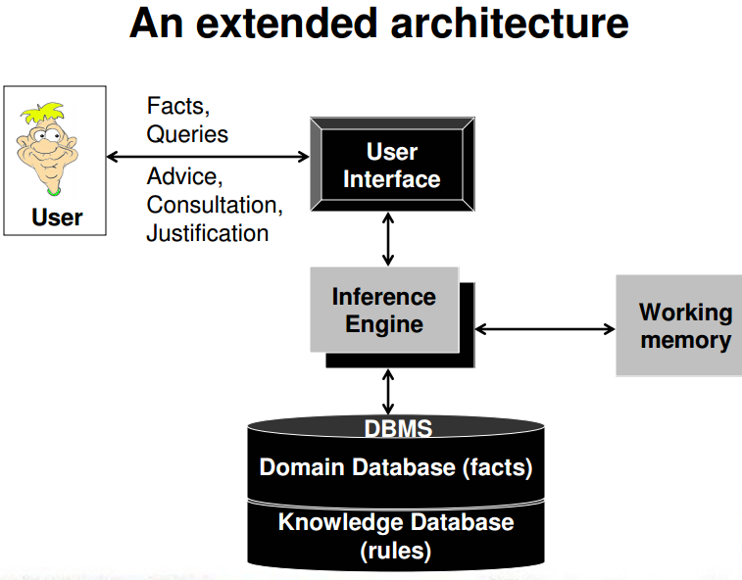

Slide 12
Other Components
Explanation facility:
  Explain the reasoning of the system to a user
Knowledge acquisition facility:
  An automatic way for the expert to enter knowledge in the system rather than by having the knowledge engineer explicitly code the knowledge
Self-training facility:
  An automatic way of the system to add new facts and/or rules in the system

Slide 13
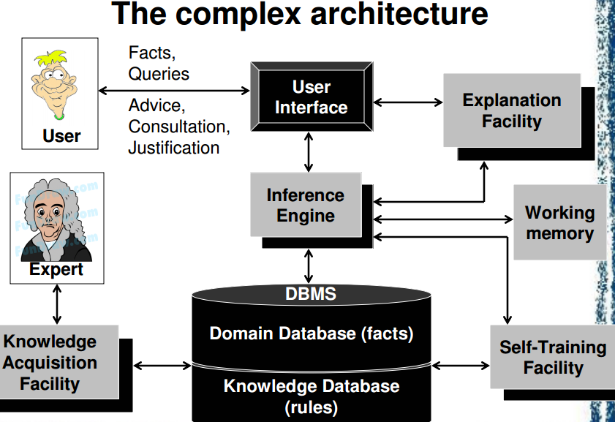

Slide 14
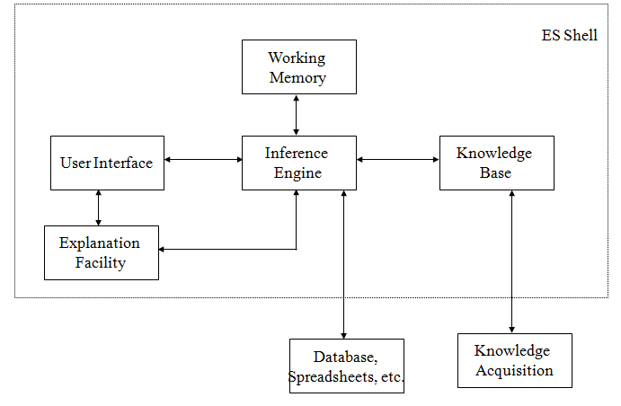

Slide 15
ES-Knowledge Base
Knowledge Base
To store knowledge from the experts of special field(s). It contains facts and feasible operators or rules for heuristic planning and problem solving.
The other data is stored in a separate database called global database, or database simply.

Slide 16
ES-Reasoning Machine(2)
Reasoning Machine
To memorize the reasoning rules and the control strategies applied.
According to the information from the knowledge base, the reasoning machine can coordinate the whole system in a logical manner, draw inference and make a decision.

Slide 17
ES- User Interface (3)
User Interface
To communicate between the user and the expert system.
The user interacts with the expert system in problem-oriented language such as in restricted English, graphics or a structure editor. The interface mediates information exchanges between the expert system and the human user.

Slide 18
ES- Interpreter(4)
Interpreter
Through the user interface, interpreter explains user questions, commands and other information generated by the expert system, including answers to questions, explanations and justifications for its behavior, and requests for data.

Slide 19
knowledge acquisition
The knowledge acquisition component allows the expert to enter their knowledge or expertise into the expert system, and to refine it later as and when required.
Historically, the knowledge engineer played a major role in this process, but automated systems that allow the expert to interact directly with the system are becoming increasingly common.

Slide 20
The knowledge acquisition process is usually comprised of three principal stages:
Knowledge elicitation is the interaction between the expert and the knowledge engineer/program to elicit the expert knowledge in some systematic way.
2. The knowledge thus obtained is usually stored in some form of human friendly intermediate representation.
3. The intermediate representation of the knowledge is then compiled into an executable form (e.g. production rules) that the inference engine can process.
In practice, many iterations through these three stages are usually required!

Slide 21
knowledge elicitation
The knowledge elicitation process itself usually consists of several stages:
1. Find as much as possible about the problem and domain from books, manuals, etc. In particular, become familiar with any specialist terminology and jargon.
2. Try to characterise the types of reasoning and problem solving tasks that the system will be required to perform.
3. Find an expert (or set of experts) that is willing to collaborate on the project. Sometimes experts are frightened of being replaced by a computer system!
4. Interview the expert (usually many times during the course of building the system). Find out how they solve the problems your system will be expected to solve. Have them check and refine your intermediate knowledge representation.
This is a time intensive process, and automated knowledge elicitation and machine learning techniques are increasingly common modern alternatives.

Slide 22
Building Expert System
The key for successfully building an expert system is to begin it from a smaller one, and extend and test it step by step, make it into a larger-scale and more perfect system.
The general procedure for building ESs :
Design of initial Knowledge Base
Development & test for prototype system
Improvement & induction for the knowledge

Slide 23
Design of initial Knowledge Base
Problem identification
Knowledge conceptualization
Concept formulization
Rule formulation
Rule validation

Slide 24
Types of Expert System (ES)
Category | Problem Addressed
Interpretation Prediction Diagnosis Design Planning Monitoring Debugging Repair Instruction Control | Inferring situation descriptions from sensor data Inferring likely consequences of given situation Inferring system malfunction from observation Configuring objects under constrains Designing actions Comparing observation to plan vulnerabilities Prescribing remedies for malfunction Executing a plan to administer a prescribed remedy Diagnosing, debugging and repairing student behavior Interpreting, predicting, repairing and monitoring system behavior

Slide 25
Expert Control Systems
Important differences between expert systems and expert control systems:
Expert systems simply complete consultative function for problems of special domains and aid users to work.
Expert control systems need to make decisions to control action independently and automatically.
Expert systems usually work in off-line mode. Expert control systems need to acquire dynamic information in on-line mode and make real-time control for the system.

Slide 26
Two main types of expert control
Two main types of expert control:
Expert control system
With a more complex structure, higher cost, better performance, and used to plants or processes where higher technical requirements are needed.
Expert controller
With a simpler structure, lower cost and has a performance that can meet the general requirements for the industrial process control.
Notes:
There are 2 main types of expert control: The Expert control system and Expert controller.
(念PPT)

Slide 27
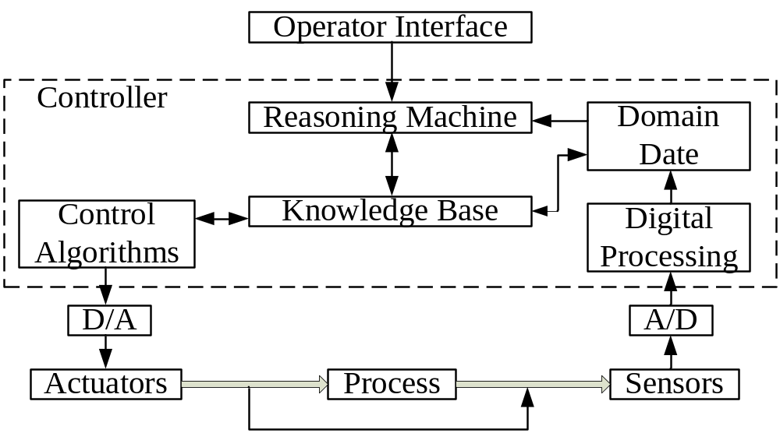
Structures of Expert Control System
A typical structure of expert control system

Slide 28
Expert system-MYCIN
An early expert system developed in early 1970s at Stanford University
Wrote by Lisp Language
Author: Bruce G. Buchanan & Edward H. Shortliffe
  <<Rule-Based Expert Systems:
  The MYCIN Experiments of the Stanford Heuristic Programming Project >>
This expert system was designed to identify bacteria causing severe infections
Notes:
Now, we’ll get a knowledge of a very famous Expert system-MYCIN.
(念PPT)

Slide 29
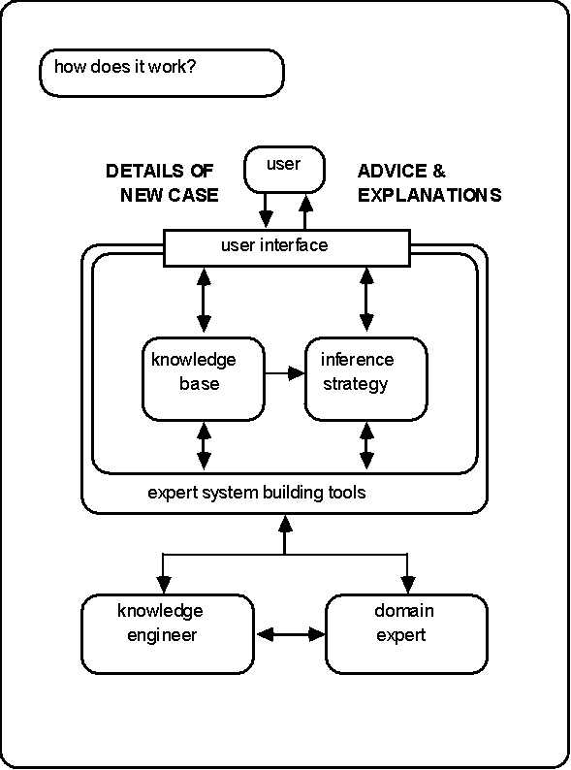

Slide 30
MYCIN: Problem Solving
When trying to prove a goal through backward chaining, system could ask user certain questions.
Certain facts are marked as “askable”, so if they couldn’t be proved, ask the user.
The ask procedure is carried out in following style of dialogue:
  MYCIN: Has the patient had neurosurgery?
  USER: No.
  MYCIN: IS the patient a burn patient?
  USER: No.
  …
  MYCIN: It could be Diplococcus..
Notes:
Neuro-surgery [njuərəu ‘sə:dʒəri] 神经外科

Slide 31
Modeling Human Diagnostic Strategies
Problem Solving Strategy used in MYCIN only works when small number of hypotheses (e.g., bacteria).
For hundreds of possible diseases, need a better strategy.
Later medical diagnostic systems used an approach based on human expert reasoning.
Notes:
Let’s have an analysis about the defects and development trend of MYCIN. (念PPT)
Diagnostic [daiəg nɔstik] 诊断的

Slide 32
Diagnostic Reasoning: Internist
Internist is a medical expert system for general disease diagnosis.
Knowledge in system consists of disease profiles, giving symptoms associated with disease and strength of association.
Notes:
Internist 内科医生

Slide 33
Summary: Expert Systems
Effective systems have been developed that capture expert knowledge in areas like medicine.
Typically combine rule-based approaches, with additional certainty/probabalistic reasoning, and some top level control of the problem solving process.
Not a huge take-up of systems, perhaps due to failure to adequately consider how they would be integrated into current practice.

Slide 34
Simple Medical Expert System
Rules
  If headache then prescribe pain killer
  If headache and sore throat and coughing than diagnose flu
  If tired and headache then diagnose glandular fever
  If tired and sore throat then diagnose tonsillitis
  If tired than diagnose stress

Slide 35
Simple Medical Expert System
User interaction
  Patient: I have a headache
  System: I suggest you take a pain killer. Do you have a sore throat?
  Patient: Yes, I do.
  System: Have you been coughing?
  Patient: No, why do you ask?
  System: If you had a head ache and a sore throat and had been coughing, I would have to conclude you might have the flu. It doesn't sound as though you have the flu? Have you been feeling tired recently?
  Patient: Yes, I have.
  System: It sounds as though you may have glandular fever or tonsillitis.

Slide 36
Problem Areas Addressed by Expert Systems
Interpretation systems
Prediction systems
Diagnostic systems
Design systems
Planning systems
Monitoring systems
Debugging systems
Repair systems
Instruction systems
Control systems

Slide 37
Expert Systems Benefits
Improved Decision Quality
Increased Output and Productivity
Decreased Decision Making Time
Increased Process(es) and Product Quality
Capture Scarce Expertise
Can Work with Incomplete or Uncertain Information
Enhancement of Problem Solving and Decision Making
Improved Decision Making Processes
Knowledge Transfer to Remote Locations
Enhancement of Other MIS

Slide 38
Lead to
Improved decision making
Improved products and customer service
Sustainable strategic advantage
May enhance organization’s image

Slide 39
Problems and Limitations of Expert Systems
Knowledge is not always readily available
Expertise can be hard to extract from humans
Expert system users have natural cognitive limits
ES work well only in a narrow domain of knowledge
Knowledge engineers are rare and expensive
Lack of trust by end-users
ES may not be able to arrive at valid conclusions
ES sometimes produce incorrect recommendations

Slide 40
Expert System
Success Factors
Most Critical Factors
  Champion in Management
  User Involvement and Training
Plus
  The level of knowledge must be sufficiently high
  There must be (at least) one cooperative expert
  The problem must be qualitative (fuzzy), not quantitative
  The problem must be sufficiently narrow in scope
  The ES shell must be high quality, and naturally store and manipulate the knowledge
  A friendly user interface
  Important and difficult enough problem

Slide 41
For Success
1. Business applications justified by strategic impact (competitive advantage)
2. Well-defined and structured applications

Slide 42
Expert Systems Types
Expert Systems Versus Knowledge-based Systems
Rule-based Expert Systems
Frame-based Systems
Hybrid Systems
Model-based Systems
Ready-made (Off-the-Shelf) Systems
Real-time Expert Systems

